Slide 1
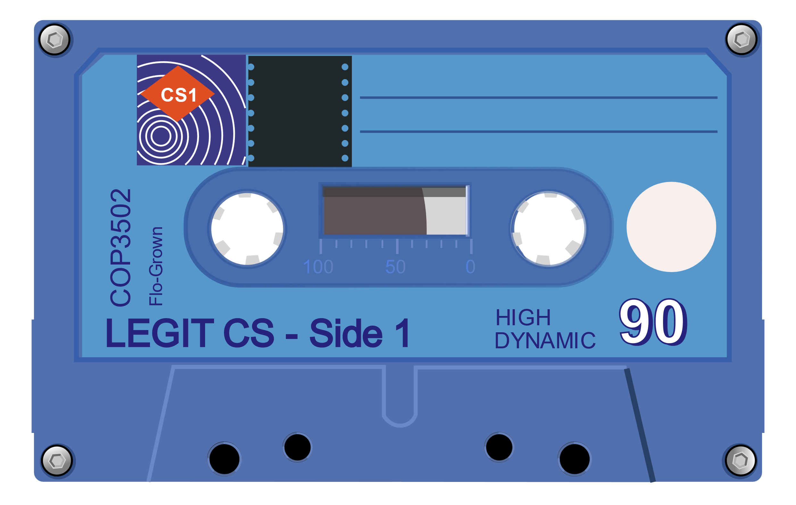
Data Types Summary
“Data! Data! Data! I can’t make bricks without clay!”
– Sir Arthur Conan Doyle
Based on slides created for COP3502 by Dr. Jeremiah Blanchard
Modified by Fernando J. Rodríguez

Slide 2
Primitive Data Types: Integers
Type | Bits | Description | Precision / Range
byte | 8 | tiny integer | -128 : +127
short | 16 | short integer | -32768 : +32767
int | 32 | just right integer | -2,147,483,648 : +2,147,483,647
long | 64 | long integer | -9 quintillion : +9 quintillion
Integers
Avoid integer overflow by using the proper-sized integer type
byte num = 127; // 01111111 = 127
num++; //Expected: 10000000 = 128
System.out.println(num); //Actual: 10000000 = -128
Solution: use a larger integer data type (i.e., int)
int num = 128; // 00000000 00000000 00000000 10000000 = 128

Slide 3

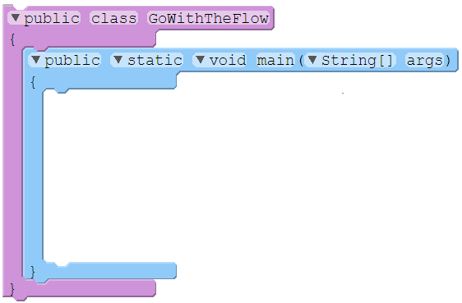
Integer OverFlow / UnderFlow
When integer numbers go too high / low, we can experience overflow and underflow:
01 02 03 04 05 06 07 08 09 10 11 12 13 14 15
import java.util.Scanner;
public class GoWithTheFlow
{
public static void main(String[] args)
{
short numCatPictures = 32725;
Scanner myScanner = new Scanner(System.in);
System.out.print("Starting with " + numCatPictures + " cat pictures. How many new ones are there? ");
numCatPictures += myScanner.nextInt();
System.out.print("We now have " + numCatPictures + ". How many were pruned out of the collection? ");
numCatPictures -= myScanner.nextInt();
System.out.println("Terminating with " + numCatPictures + " pictures of cats.");
}
}
OUTPUT:
100
Starting with 32725 cat pictures. How many new ones are there?
We now have -32711 . How many were pruned out of the collection?
Terminating with 32425 pictures of cats.
400

Slide 4
Primitive Data Types: Floating Point
Type | Bits | Description | Precision / Range
float | 32 | floating point number | (+/-)1.4·10⁻⁴⁵ : (+/-)3.4·10³⁸
double | 64 | double-precision FPN | (+/-)4.9·10⁻³²⁴ : (+/-)1.8·10³⁰⁸
Floating point
Floating point numbers are sometimes approximated and difficult to compare directly
double x = 0.1 + 0.1 + 0.1 + 0.1 + 0.1 + 0.1; //x = 0.6
double y = 0.1 * 6; //y = 0.6
boolean sameNumbers = x == y; //Expected: true, Actual: false
Solution: Define a threshold and compare the difference between two values
final THRESHOLD = 0.0001;
boolean sameNumbers = Math.abs(x – y) < THRESHOLD;

Slide 5



Floating Point Numbers
05 06 07 08 09 10 11 12 13
double cost, multiplier;
float taxPercent = 10.0f;
Scanner scanner = new Scanner(System.in);
System.out.print("What is the original cost of the item? ");
cost = scanner.nextDouble();
multiplier = 1.0 + taxPercent / 100.0f;
System.out.println("Final cost: " + cost * multiplier + ".");
float literal
double literal
OUTPUT:
What is the original cost of the item?
Final cost: 11.11.
10.10

Slide 6
Floating Point Issues
When using floating point numbers, we can get some funny results…
5.0 / 0.0
-5.0 / 0.0
Math.sqrt(-1.0)
Infinity
-Infinity
NaN
You messed up (toward positive infinity)
You messed up (toward negative infinity)
WTF!!! (Not a Number)
Moral: Use floats when you need them, but not when you don’t.

Slide 7
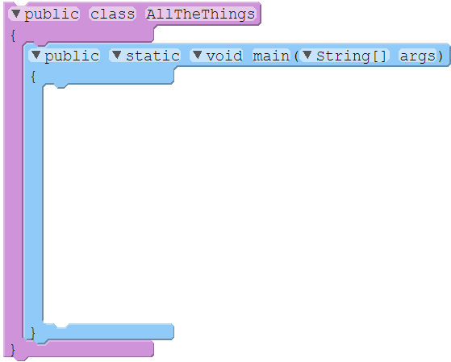





Floating Point, Revisited
Floating point numbers give us better precision, but sometimes lower accuracy:
01 02 03 04 05 06 07 08 09 10 11 12 13 14 15
public class AllTheThings
{
public static void main(String[] args)
{
float myLulz = 0.7f;
float yourLulz = 0.4f;
float lolDiff = myLulz – yourLulz;
lolDiff –= 0.3f;
if (lolDiff == 0)
System.out.println("SOMEONE TOOK ALL THE THINGS!");
else
System.out.println("Difference is " + lolDiff);
}
}
0.6999999999999999555910790
0.4000000000000000222044605
0.2999999999999999888977697
Not zero!
OUTPUT:
Difference is -2.9802322E-8.

Slide 8

Floating Point Comparison
To catch edge cases, define a delta value (buffer) for comparisons:
01 02 03 04 05 06 07 08 09 10 11 12 13 14 15
public class AllTheThings
{
public static void main(String[] args)
{
float myLulz = 0.7f;
float yourLulz = 0.4f;
float lolDiff = myLulz – yourLulz;
lolDiff = lolDiff – 0.3f;
if (lolDiff < 0.00001)
System.out.println("SOMEONE TOOK ALL THE THINGS!");
else
System.out.println("Difference of the lulz is " + lolDiff);
}
}
Delta value
OUTPUT:
SOMEONE TOOK ALL THE THINGS!

Slide 9
Primitive Data Types: Boolean
Type | Bits | Description | Precision / Range
boolean | 1 | truth value | true, false
Name | Op | Example | Value
Less than | < | 5 < 5 | false
Greater than | > | 6 > 3 | true
Less than or equal to | <= | 3 <= 3 | true
Greater than or equal to | >= | 6 >= 7 | false
Equal to | == | 10 == 10 | true
Not Equal to | != | 10 != 9 | true
Name | Op | Function | Example | Value
NOT | ! | Value is opposite operand’s value | !(3 > 4) | true
AND | && | True if both sides are true | 4 > 3 && 3 > 2 | true
OR | || | True if either side is true (or both) | 4 > 3 || 2 > 3 | true

Slide 10

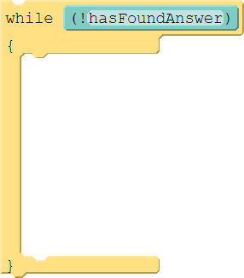

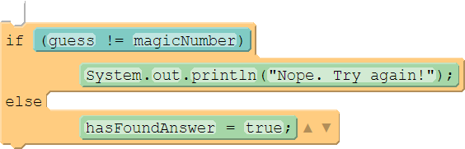
Boolean Variables
We can store truth values using a boolean type:
05 06 07 08 09 10 11 12 13 14 15 16 17 18 19 20 21 22 23
public static void main(String[] args)
{
System.out.println("Try to guess my number (0-100)!");
Scanner myScanner = new Scanner(System.in);
int magicNumber = (int) Math.round(Math.random() * 100.0);
boolean hasFoundAnswer = false;
while (!hasFoundAnswer)
{
System.out.print("What’s your guess? ");
int guess = myScanner.nextInt();
if (guess != magicNumber)
System.out.println("Nope. Try again!");
else
hasFoundAnswer = true;
}
System.out.println("Thanks for playing!");
}
OUTPUT:
Try to guess my number (1-100)!
What's your guess? 15
Nope. Try again!
What's your guess? 37
Nope. Try again!
What’s your guess? 42
Thanks for playing!

Slide 11
Character Data Type
“Data! Data! Data! I can’t make bricks without clay!”
– Sir Arthur Conan Doyle
Based on slides created for COP3502 by Dr. Jeremiah Blanchard
Modified by Fernando J. Rodríguez

Slide 12
Primitive Data Types: Characters
Type | Bits | Description | Precision / Range
char | 16 | character | All Unicode
A character is a single symbol (letters, numbers, punctuation, etc.):
char letter = 'A';
A character literal is indicated via single quotations:
'A' is a character, but “A” is a String
Letters | Digits | Grammatical symbols | Escape sequences
'A' | '0' | '?' | '\n' (newline)
'B' | '1' | '!' | '\t' (tab)
'Z' | '2' | '#' | '\\' (backslash)
'a' | '7' | '$' | '\"' (double quotes)
'z' | '9' | ' ' (space) | '\'' (single quote)

Slide 13
Character ASCII Encoding
Internally, characters are stored based on their ASCII encoding
char letter = 'A';
Memory
letter: 65
char | ASCII |  | char | ASCII |  | char | ASCII |  | char | ASCII
'A' | 65 |  | '0' | 48 |  | '?' | 63 |  | '\n' (newline) | 10
'B' | 66 |  | '1' | 49 |  | '!' | 33 |  | '\t' (tab) | 9
'Z' | 90 |  | '2' | 50 |  | '#' | 35 |  | '\\' (backslash) | 92
'a' | 97 |  | '7' | 55 |  | '$' | 36 |  | '\"' (double quotes) | 34
'z' | 122 |  | '9' | 57 |  | ' ' (space) | 32 |  | '\'' (single quote) | 39

Slide 14
Character Operations
Characters are primitive types, so they may be compared directly
char letter1 = 'A';
char letter2 = 65;
boolean sameLetter = letter1 == letter2; //evaluates to true
You can also apply mathematical operators to characters
char letter = 'H';
letter += 32;
System.out.println(letter); //prints lowercase h

Slide 15
Character Class Methods
Function | Description | Example | Value
isDigit(char) | true if char is [0-9] | Character.isDigit('a') | false
isLetter(char) | true if char is [a-z,A-Z] | Character.isLetter('q') | true
isWhitespace(char) | true if char is whitespace | Character.isWhitespace('\t') | true
toUpperCase(char) | returns uppercase of letter | Character.toUpperCase('j') | 'J'
toLowerCase(char) | returns lowercase of letter | Character.toLowerCase('Z') | 'z'
How to read a single character from user input
Scanner scn = new Scanner(System.in);
char symbol = scn.next().charAt(0);

Slide 16
Practice
Write a program that asks the user for a letter and prints the letter in uppercase if it is an alphabetical letter; otherwise, the program should tell the user they need to enter a letter.
Sample output #1
Enter a letter: b
Uppercase: B
Sample output #2
Enter a letter: ?
Please enter an alphabetical letter.
BONUS: Keep asking the user for a letter until they enter one

Slide 17
Constants
“Data! Data! Data! I can’t make bricks without clay!”
– Sir Arthur Conan Doyle
Based on slides created for COP3502 by Dr. Jeremiah Blanchard
Modified by Fernando J. Rodríguez

Slide 18
COnstants
Constants: variables with values that do not change
Declare using the final keyword
final double PI = 3.14;
Use uppercase and underscores for constant names
final int SPEED_OF_LIGHT = 299792458;
Constants can be used in expressions like variables
double radius = 2.0;
final double PI = 3.14;
double circleArea = PI * radius * radius;

Slide 19

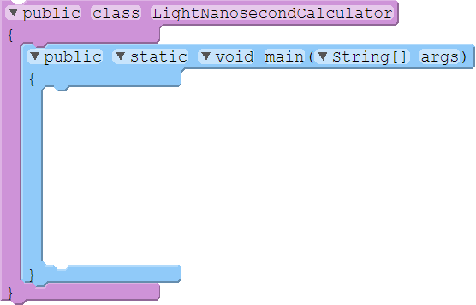

Constant Values
Sometimes we have values that never need to change. These constants can be handled more efficiently (and safely) if we tell the compiler:
01 02 03 04 05 06 07 08 09 10 11 12 13 14 15
import java.util.Scanner;
public class LightNanosecondCalculator
{
public static void main(String[] args)
{
final double LIGHT_NANOSECOND_M = 299792458.0 / 1000000000.0;
final double M_PER_FT = 0.3048;
System.out.print("What is your height in feet?");
Scanner myScanner = new Scanner(System.in);
double height = myScanner.nextDouble() * M_PER_FT / LIGHT_NANOSECOND_M;
System.out.println("You are " + height + " light-nanoseconds tall!");
}
}
OUTPUT:
5.5
What is your height in feet?
You are 5.59186849 light-nanoseconds tall!

Slide 20
Type Conversion
“Data! Data! Data! I can’t make bricks without clay!”
– Sir Arthur Conan Doyle
Based on slides created for COP3502 by Dr. Jeremiah Blanchard
Modified by Fernando J. Rodríguez

Slide 21
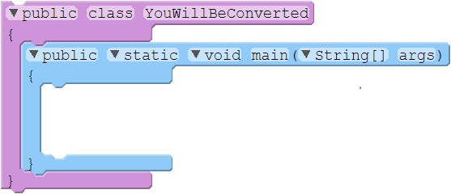

Type Conversion - Implicit
Java (and most languages) can implicitly convert between many basic types, depending on the operation and types involved:
01 02 03 04 05 06 07 08 09
public class YouWillBeConverted
{
public static void main(String[] args)
{
final double TAU = Math.PI * 2;
System.out.println("Tau's value is " + TAU);
}
}
Assignment right type → left type
Arithmetic integer → floating pt.
String Concatenation other type → String
OUTPUT:
Tau's value is 6.283185307179586

Slide 22
Examples of Implicit Type Conversion
7.0 / 2
(double) / (int)
(double)
"Hello" + 23 + 5
(String) + (int) + (int)
(String) + (int)
(String)
'X' + 6
(char) + (int)
(int)
When evaluating an expression, the data type of the result is determined by the data type of the operand that occupies the most space in memory

Slide 23
Examples of Implicit Type Conversion
double div = 7.0 / 2;
(double)
String message = "Hello" + 23 + 5;
(String)
char symbol = 'X' + 6;
(char)
In a variable assignment, the data type is determined by the data type of the variable (as long as the assignment is compatible)

Slide 24
Explicit Type Conversion - Casting
Type casting: explicitly convert one data type to another
(<type>) <expression>
Examples:
int num1 = (int) (5.0 / 2.0) //Results in 2
double num2 = ((double) 5) / 2 //Results in 2.5
char letter = (char) (60 + 5) //Results in 'A'
Only use type casting when you know the value will fit in the new data type
char letter = (char) (2000000000) //Unexpected result

Slide 25
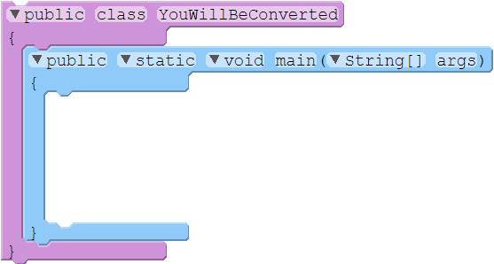

Type Conversion - Explicit
We can explicitly convert types –known as type casting:
01 02 03 04 05 06 07 08 09 10 11
public class YouWillBeConverted
{
public static void main(String[] args)
{
final double TAU = Math.PI * (double) 2;
final double TWO_TAU = TAU * 2.0;
System.out.println("Double double-tau: " + TWO_TAU);
System.out.println("Integer double-tau: " + (int) TWO_TAU);
}
}
Integer → Floating Point Perfect conversion
Floating Point → Integer
Possible information loss
OUTPUT:
Double double-tau: 12.566370614359172
Integer double-tau: 12

Slide 26
Practice
Write a program to calculate the average of three user-entered integers. Use constants and type casting as needed
Sample output
Enter first number: 12
Enter second number: 33
Enter third number: 29
Average: 24.666666666666668

Slide 27

Introduction to Objects
“Objects are abstractions of processing. Threads are abstractions of schedule.”
– James O. Coplien, Computer Scientist
Based on slides created for COP3502 by Dr. Jeremiah Blanchard
Modified by Fernando J. Rodríguez

Slide 28
Introduction to Objects and String Class
“Objects are abstractions of processing. Threads are abstractions of schedule.”
– James O. Coplien, Computer Scientist
Based on slides created for COP3502 by Dr. Jeremiah Blanchard
Modified by Fernando J. Rodríguez

Slide 29
Objects in Real life
Objects in the real world have characteristics and behaviors
Cat
Characteristics: whiskers, paws, tail, collar, …
Behaviors: meow, scratch, bite, run, jump, …
Student
Characteristics: major, academic year, GPA, backpack, …
Behaviors: eat, sleep, study, party…

Slide 30
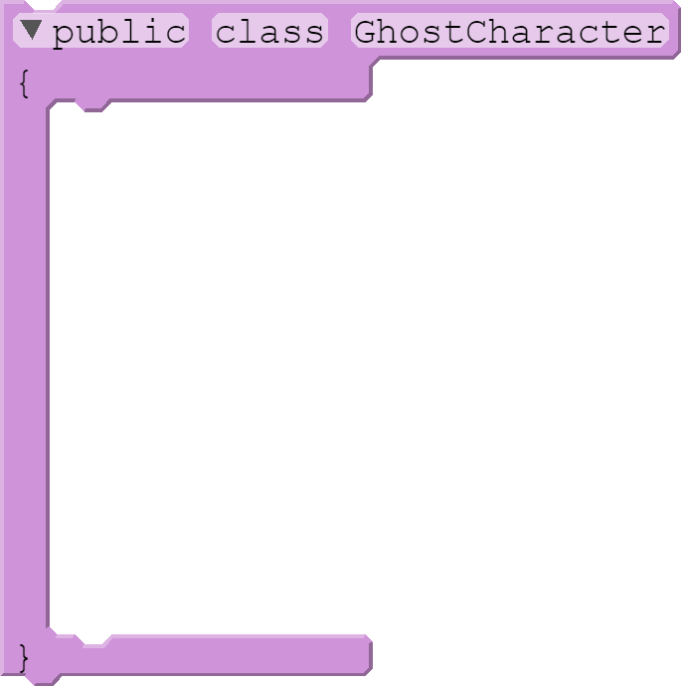








Object Oriented Programming
Object oriented programming combines attributes and methods into an object.
public class GhostCharacter
{
public int x, y;
public boolean isEdible;
public void moveUp() { … }
public void moveDown() { … }
public void moveLeft() { … }
public void moveRight() { … }
public int getX() { … }
public int getY() { … }
}
A class is a definition (like a blueprint), while an object is an instance (like a building).

Slide 31
What is a “string”, anyway?
A string is a sequence of symbols (like characters) in computer science. Java strings are…
Represented by String class instances (class: blueprint; instance: building)
Built into the language itself (no import necessary)
Are immutable – once created, they can’t be changed!
Unlike most types covered so far (char, boolean, int, float, etc), which are primitive types (variables hold their own values), String is a reference type (variables hold a reference to the object):
int homeNumber
8675309
String farewell
6A7ABA17
6A7ABA17
“See you later, Al E. Gator!”
int joesNumber
8675309
String goodbye
6A7ABA17

Slide 32
Instance Methods
Instance methods can only be invoked by an instance of the class. They have this format:
Here are some instance methods provided by the String class in Java:
String icecream = "Deep-fried icecream...";
String onAStick = icecream.concat("on a stick!");
reference
.method
( arguments );
Type | Method / Parameters | Description
int | length() | Returns the number of characters in this string
char | charAt(int index) | Returns the character at specified index from this string
String | concat(String s1) | Returns new string that concatenates this string with s1
String | toUpperCase() | Returns new string with all letters in uppercase
String | toLowerCase() | Returns new string with all letters in lowercase
String | trim() | Returns new string with whitespace chars. trimmed (both sides)
String | substring(begin) | Returns this string’s substring from begin to the end of string
String | substring(start,end) | Returns this string’s substring from begin to end - 1

Slide 33


Characters in a String
The characters in a String can be accessed by indices starting at 0 (not 1):
String hello = "Hello world!";
System.out.println("The third character is '" + hello.charAt(2) + "'");
Output
The third character is 'l'↵
The same indexing is used for substrings:
String welcome = "Welcome to Java";
System.out.println("[" + welcome.substring(0, 11) + "]");
System.out.println("[" + welcome.substring(11) + "]");
Output
[Welcome to ]↵
[Java]↵

Slide 34
Finding Characters and Substrings
The String class also has methods to locate a character or substring within an instance:
Type | Method / Parameters | Description
int | indexOf(ch) lastIndexOf(ch) | Returns the first / last index of ch in this string, or -1 if not matched.
int | indexOf(ch, fromIdx) lastIndexOf(ch, fromIdx) | Returns the first / last index of ch in this string at or after fromIdx, or -1 if not matched.
int | indexOf(s) lastIndexOf(s) | Returns the first / last index of s in this string, or -1 if not matched.
int | indexOf(s, fromIdx) lastIndexOf(s, fromIdx) | Returns the first / last index of s in this string at or after fromIdx, or -1 if not matched.

Slide 35
Static Methods
Static methods can be invoked without an instance the class. They have this format:
Here are some static methods provided by the String class in Java:
String theAnswer = String.valueOf(42);
class
.method
(args);
Type | Method / Parameters | Description
String | valueOf(char symbol) | Returns a new string of the specified character symbol
String | valueOf(int number) | Returns a new string of the specified integer number
String | valueOf(float number) | Returns a new string of the specified float number
String | valueOf(boolean tVal) | Returns a new string of the specified truth value

Slide 36
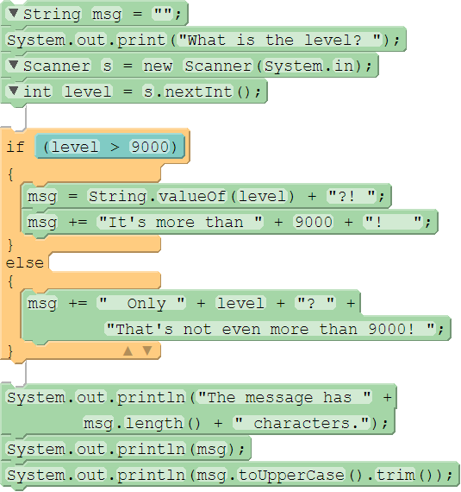
Comparing Instance and Static Methods
Instance methods usually act on objects – reading or changing them – while static methods are commonly used when a specific, existing instance is not needed. Here are a few more examples of these instance methods in action:
String msg = "";
System.out.print("What is the level? ");
Scanner s = new Scanner(System.in);
int level = s.nextInt();
if (level > 9000)
{
msg = String.valueOf(level) + "?! ";
msg += "It's more than " + 9000 + "! ");
}
else
{
msg += " Only " + level + "? " +
"That's not even more than 9000! ");
}
System.out.println("The message has " +
msg.length() + " characters.");
System.out.println(msg);
System.out.println(msg.toUpperCase().trim());
Example 1:
msg:
What is the level?
The message has 30 characters.↵
9001?! It's more than 9000! ↵
9001?! IT'S MORE THAN 9000!↵
Example 2:
msg:
What is the level?
The message has 44 characters.↵
Only 777? That's not even more than 9000! ↵
ONLY 777? THAT'S NOT EVEN MORE THAN 9000!↵
"9001?! "
"9001?! It's more than 9000! "
""
Instance method. must use reference variable – not Scanner.nextInt!
9001↵
""
" Only 777? That's not even more than 9000! "
777↵

Slide 37
Practice
Write a program that asks the user to enter a sentence and prints each word of the sentence in its own line.
Sample output
Enter a sentence: Java is fun!
Java
is
fun!

Slide 38
Enumerations
“Data! Data! Data! I can’t make bricks without clay!”
– Sir Arthur Conan Doyle
Based on slides created for COP3502 by Dr. Jeremiah Blanchard
Modified by Fernando J. Rodríguez

Slide 39
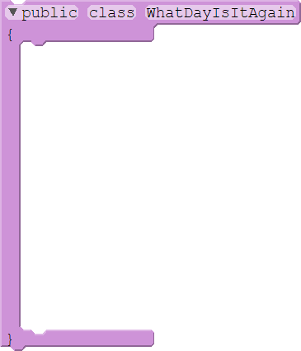
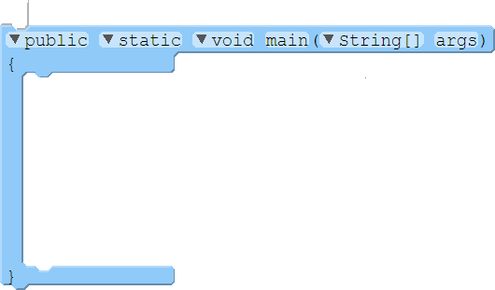
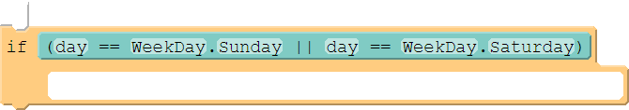

Enumerations
When we want to have a set of values that are non-numeric, we can use an enumeration:
01 02 03 04 05 06 07 08 09 10 11 12 13 14
public class WhatDayIsItAgain
{
enum WeekDay { Sunday, Monday, Tuesday, Wednesday, Thursday, Friday, Saturday }
public static void main(String[] args)
{
WeekDay day = WeekDay.Sunday;
if (day == WeekDay.Sunday || day == WeekDay.Saturday)
System.out.println("I'm so glad it’s " + day + "!");
else
System.out.println("Ugh. " + day + " is the worst.");
}
}
OUTPUT:
I'm so glad it’s Sunday!
An array of the enumeration’s elements can be accessed with the values() method.

Slide 40
Practice
Write a program that uses an enum to keep track of a user’s online status (i.e., ONLINE, BUSY, OFFLINE). The user should start out as online, then the program asks the user if they would like to change their status. The program then displays the user’s status based on what they chose. Try using methods!
Sample output #1
User is online.
Press 1 to change to busy, 2 to change to offline: 1
User is busy.
Sample output #2
User is online.
Press 1 to change to busy, 2 to change to offline : 10
User is online.

